Slide 1

INSURANCE ANALYTICS
- SANGEETHA S

Slide 2

What IS INSURANCE
Insurance is an arrangement in which you pay money to a company, and they provide financial protection for your property, life, or health, paying you in case of death, loss, or damage. Before buying insurance, make sure that the coverage provided exactly suits your needs.

Slide 3
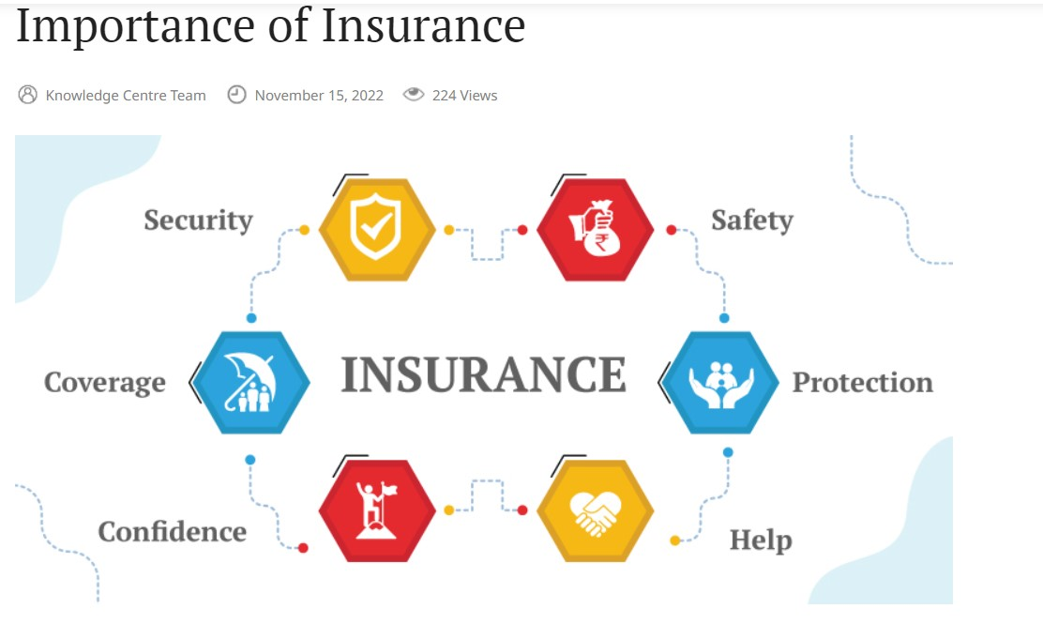
KPI’S LIST
No of meeting By Account Executive
Yearly Meeting Count
No of Invoice by Account Executive
Top-4 Opportunity by revenue
Stage Funnel by Revenue
Opportunity-Product Distribution
Top-4 Open Opportunity
Cross Sell--Target, Achievement, new
New-Target, Achievement, new
Renewal-Target, Achievement, new

Slide 4
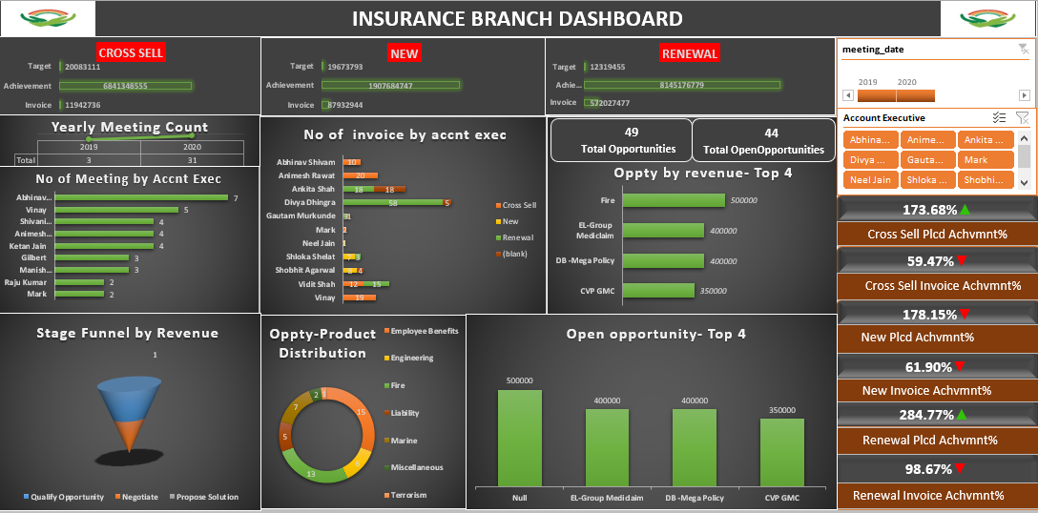
dashboard {EXCEL}

Slide 5
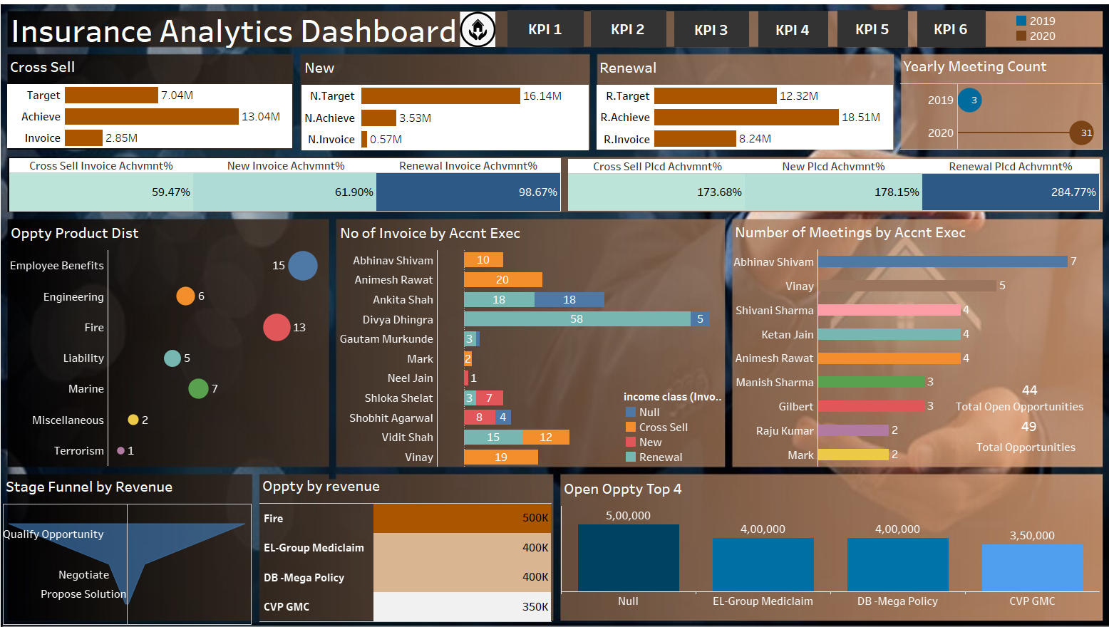
dashboard {Tableau}

Slide 6
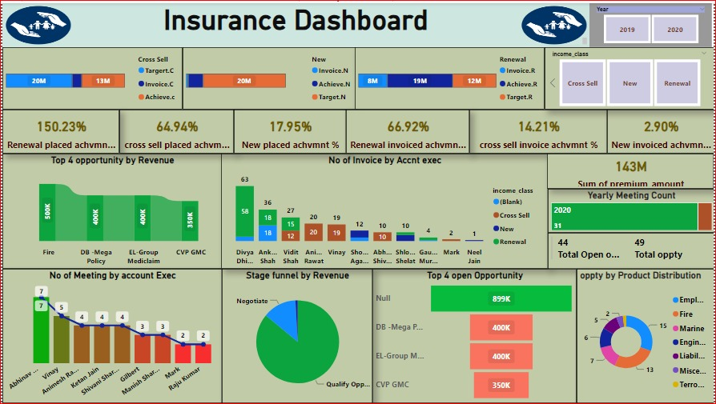
dashboard {Power Bi}

Slide 7
SUMMARY
In comparison with income class (new,cross sell, renewal)cross sell budget has highest total budget (20,083,111)most commonly in Ahmedabad branch.
Invoice : cross sell : invoice achieved by income class cross sell is about 0.59466(59.47%) , new has 61.90% ,renewal has 98.67% .
Renewal has more invoice achievement than other income classes that is 98.67% .
In 2 years 34 meetings are held in that account executive Abhinav shivam attend the more no of meetings.
49 total opportunities and 44 open opportunity are there
Compare to other ,qualified opportunity has more opportunity, least is purpose solutions .
Employee benefits has the more product distribution .

Slide 8

Thank you

